Slide 1
Standing Desk Controller
Jason Porter & Corey Buchanan
Notes:
Jason -

Slide 2
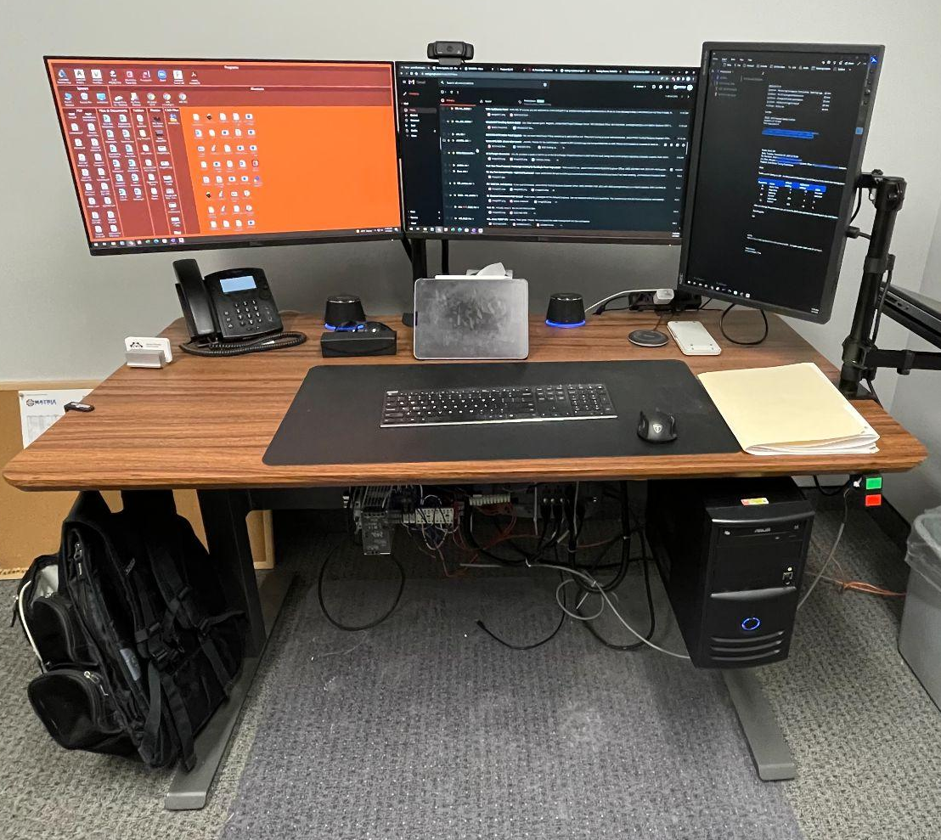
Project Description
Design and fit a new elevator controller on this standing desk.
All hardware in working condition:
Motors
Elevator screws
Structure/brackets
Existing Controller & Interface have failed.
Notes:
Jason

Slide 3
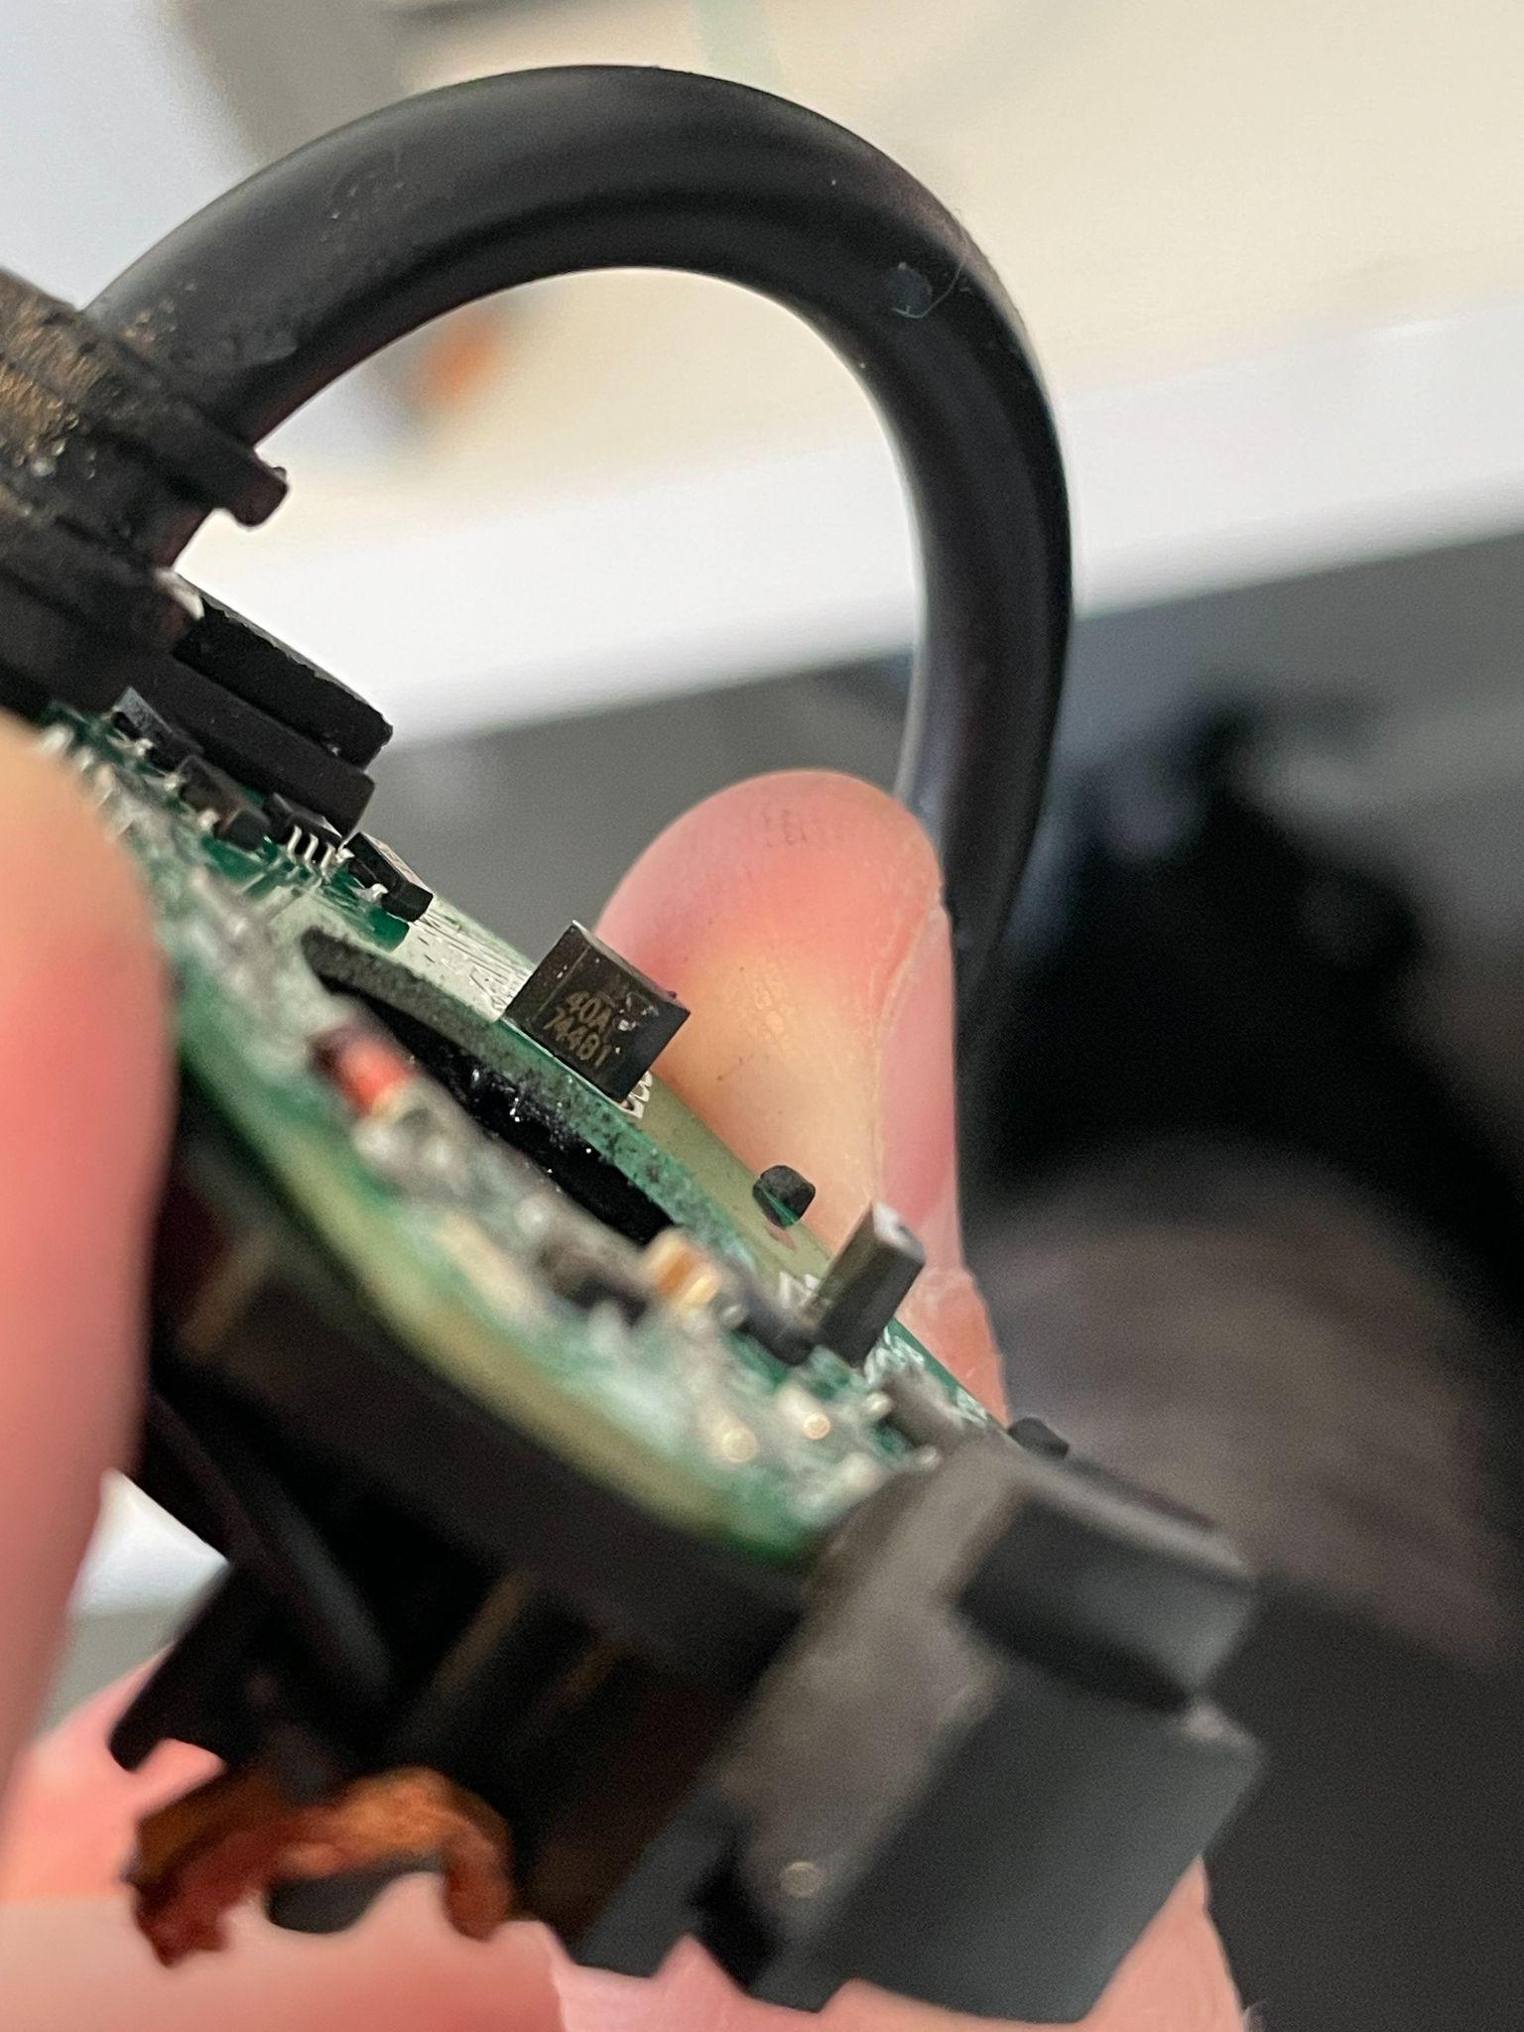
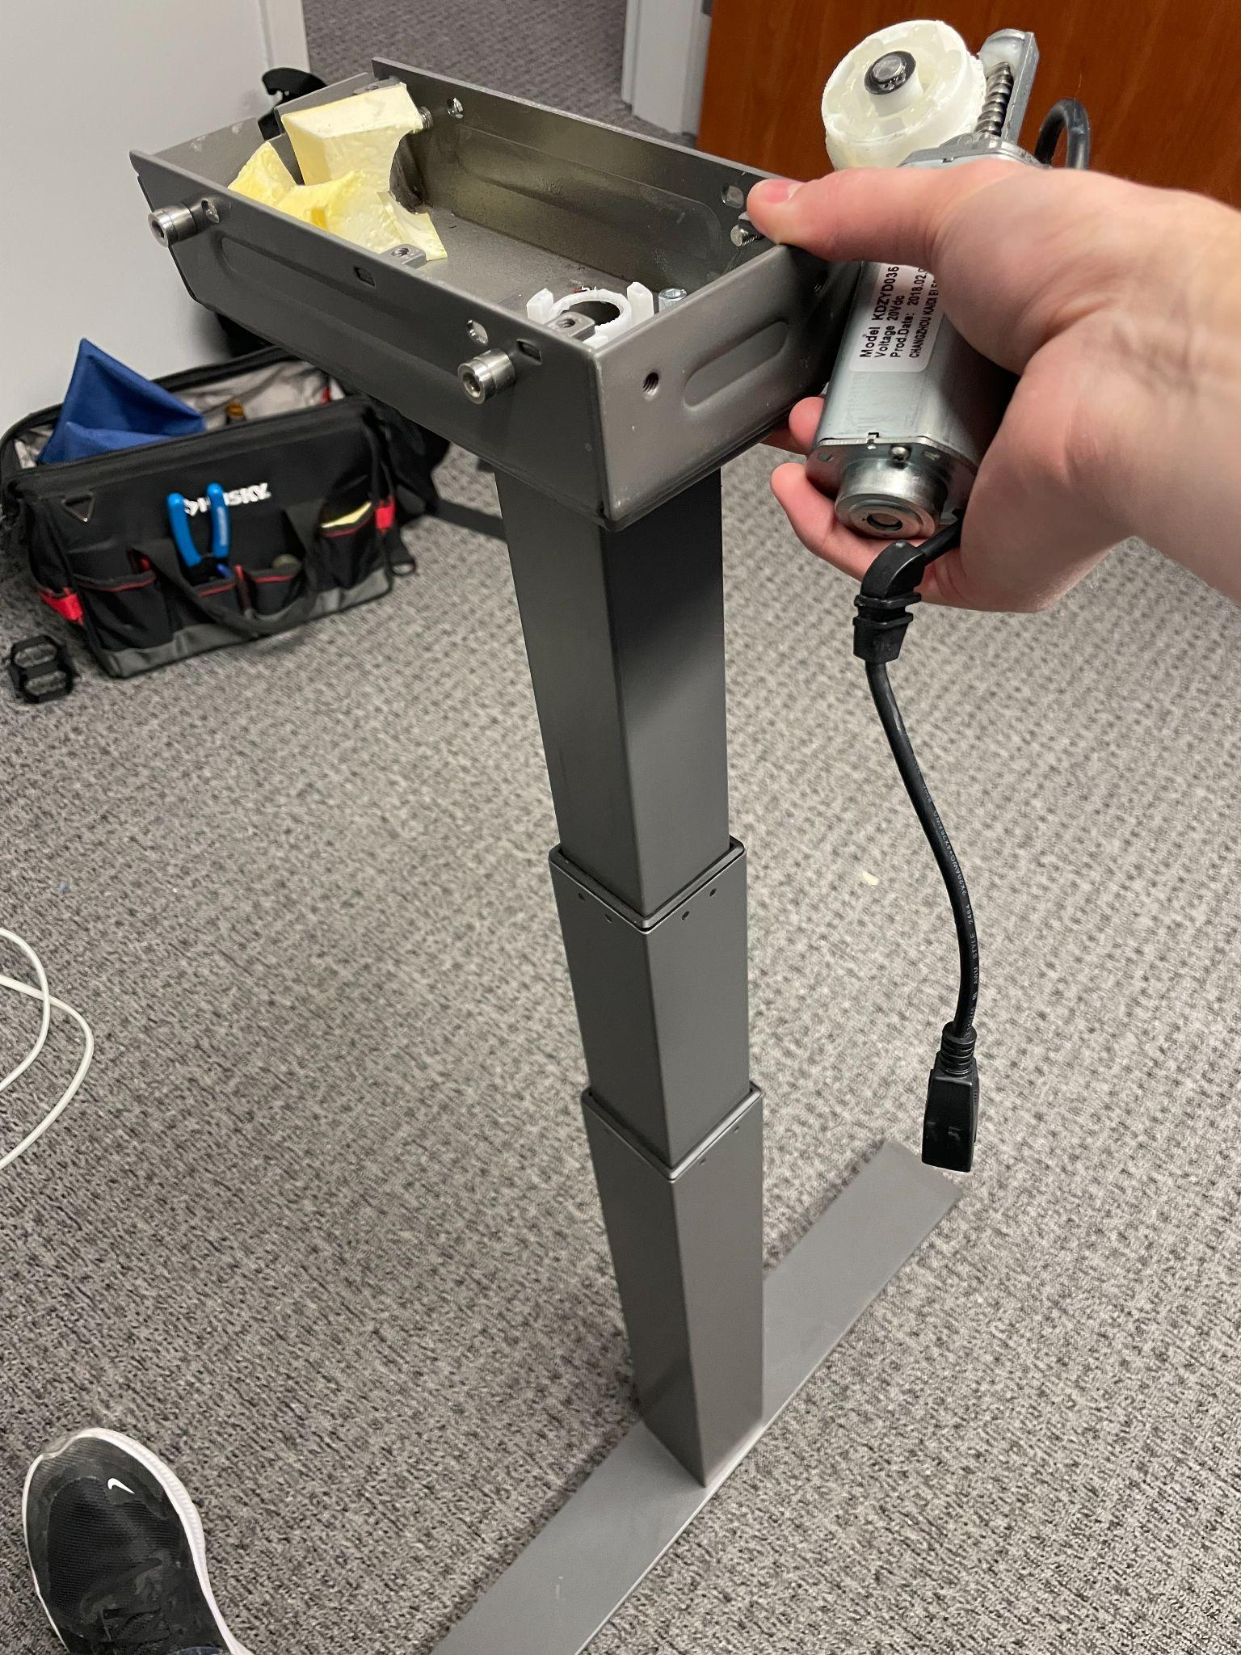
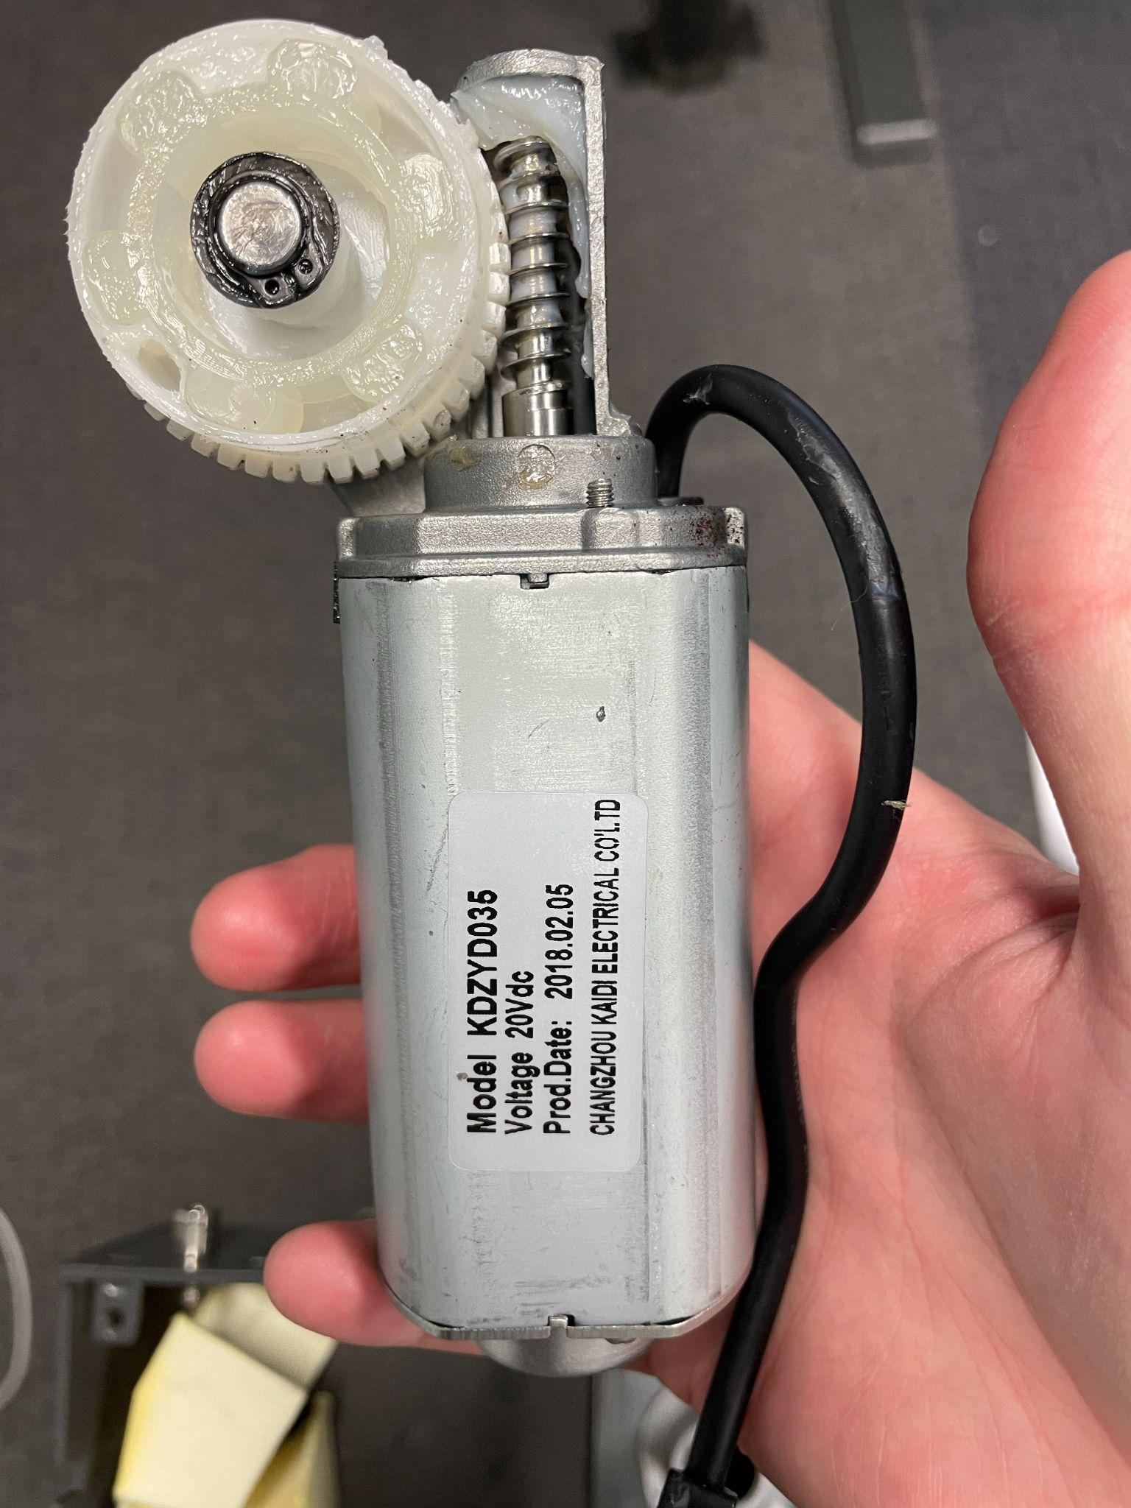
Notes:
Jason

Slide 4
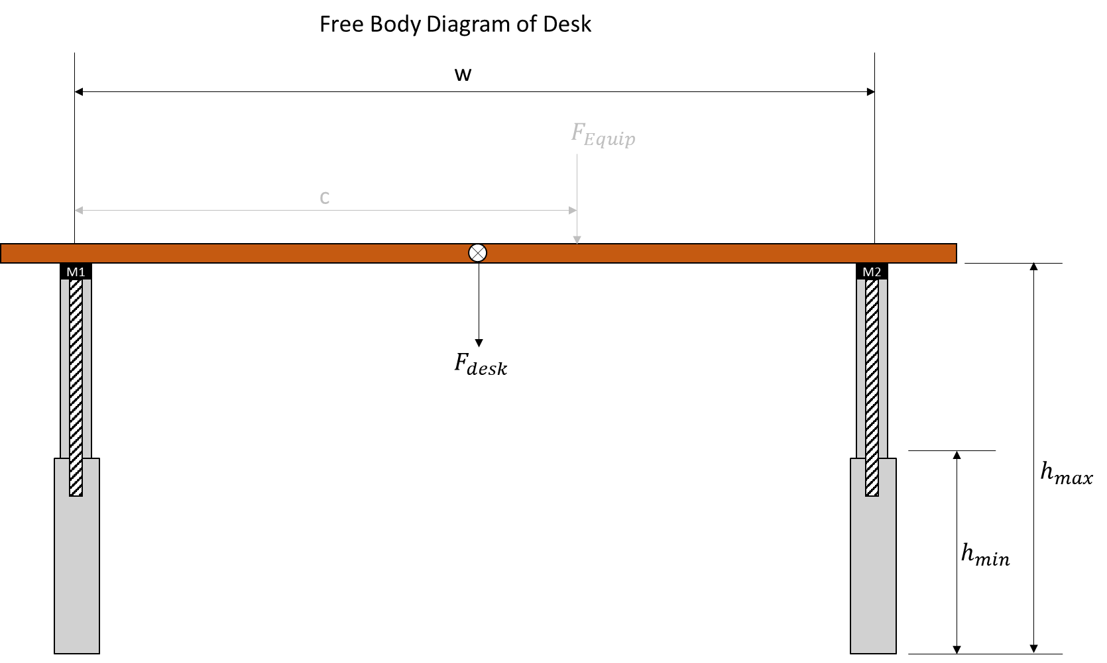
Notes:
Jason

Slide 5
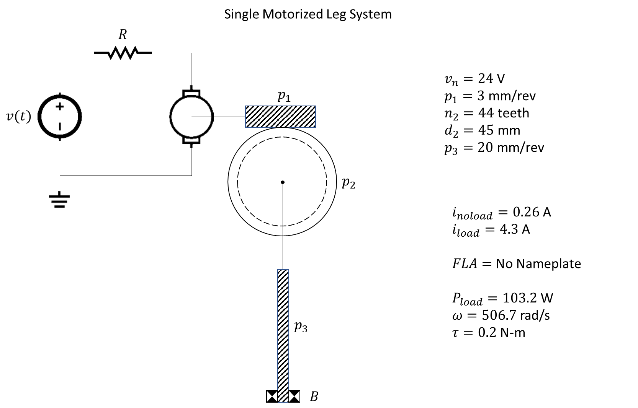
Notes:
Jason

Slide 6
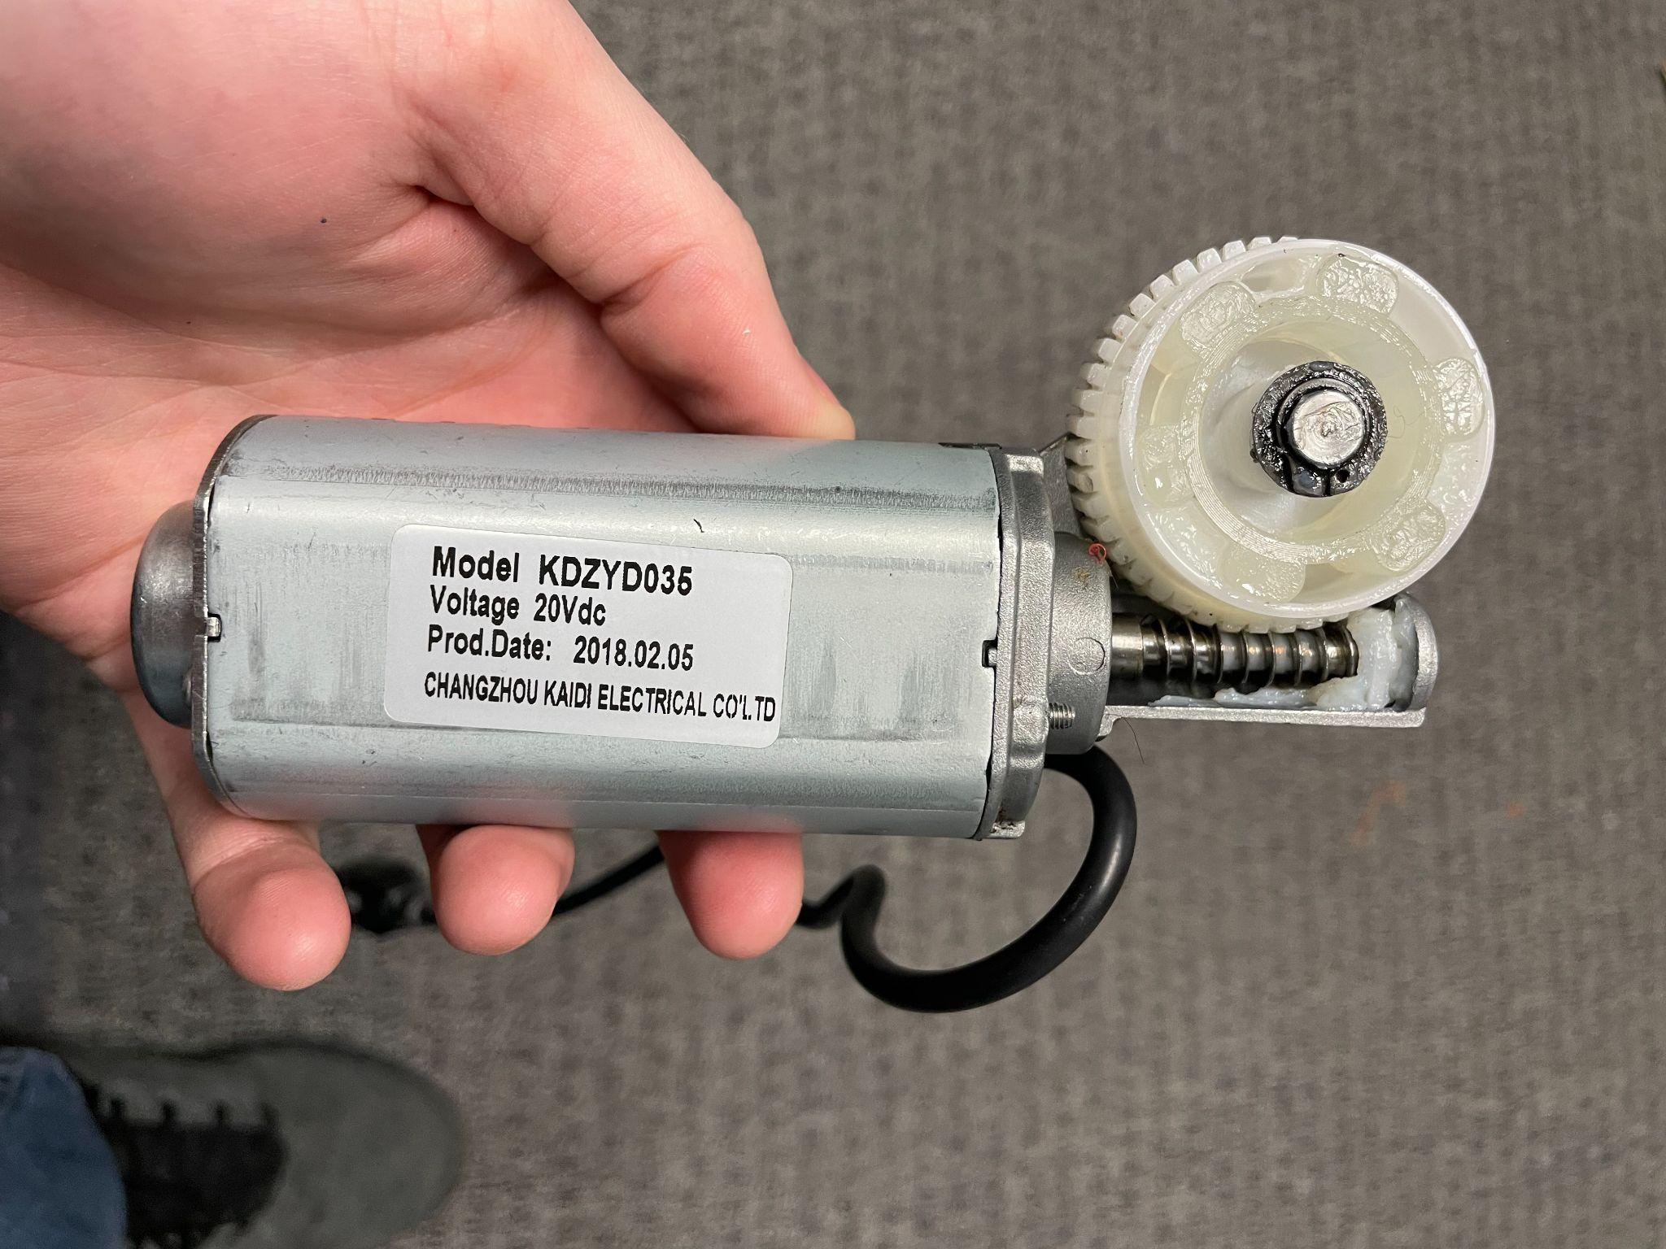
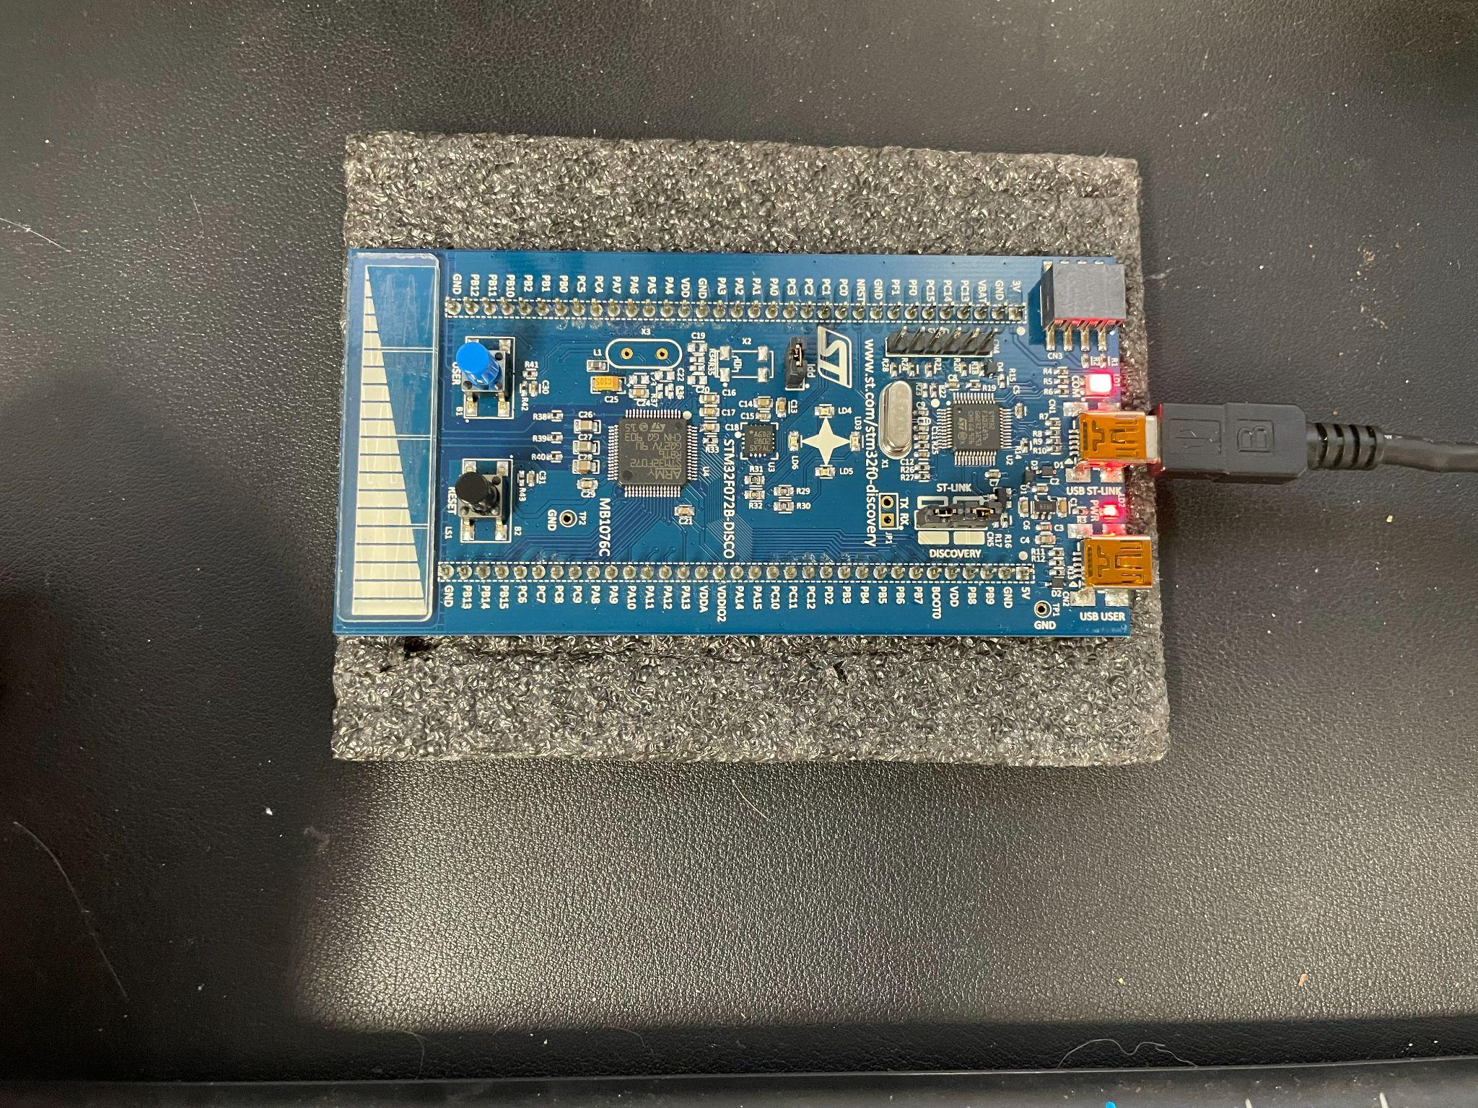
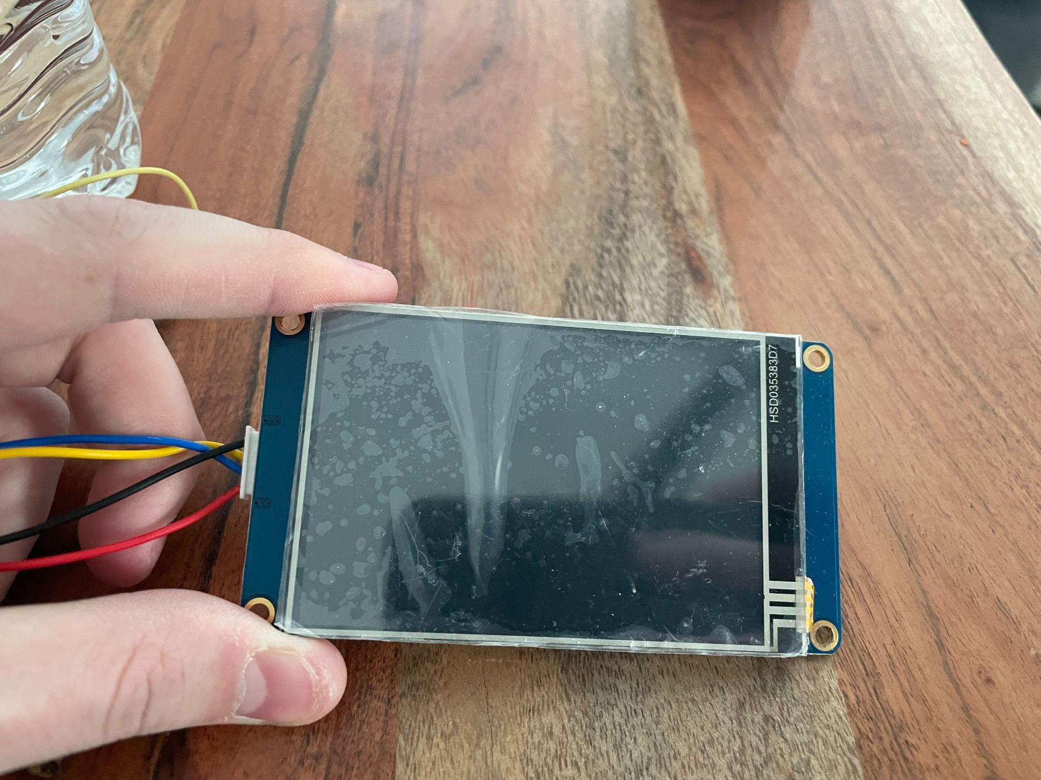
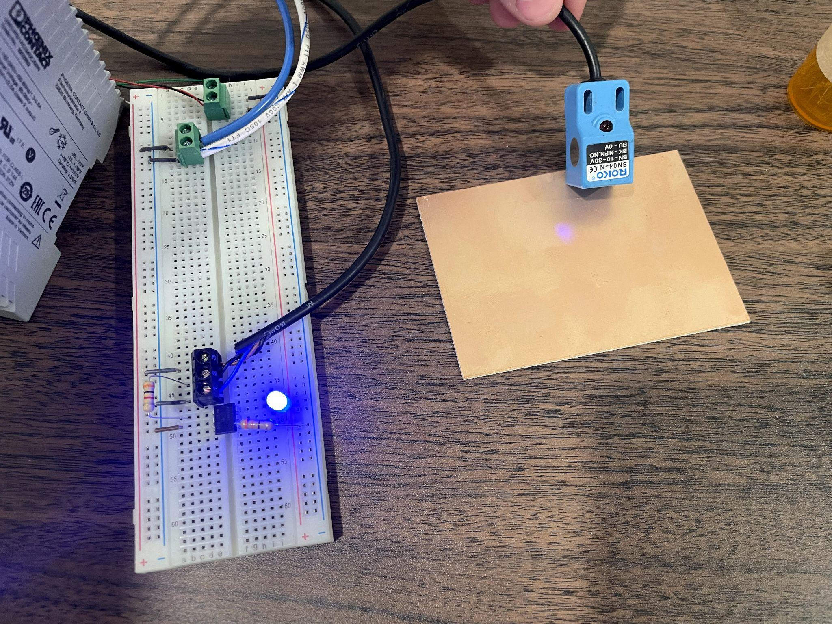
Components
(2) DC Motors w/ Quadrature Encoders
(2) Proximity Sensors
(1) Nextion HMI Touchscreen
(1) Buzzer
(1) STM32 MCU
Notes:
Jason -

Slide 7
Design
Timers
PWM for Motor Speed Control (TIM14 & 17)
Quadrature Encoders (TIM2 & 3)
UART (non-blocking)
Read/write to HMI (USART1)
Interrupts
Proxy Sensors (EXT0 & 3)
UART Read Char (USART1)
GPIO
6 Inputs / 7 Outputs
2 pins for TX/RX
Notes:
Corey -
Our project implements concepts from at least 4 of this semester’s labs. We used PWM to control the DC motors. Next, we implemented UART in a non-blocking mode to receive commands from the HMI Touchscreen. We used timers to slowly ramp the speed of the motors up so that operation of the desk would be smooth. Finally, both the UART and the limit switches make use of interrupts.

Slide 8
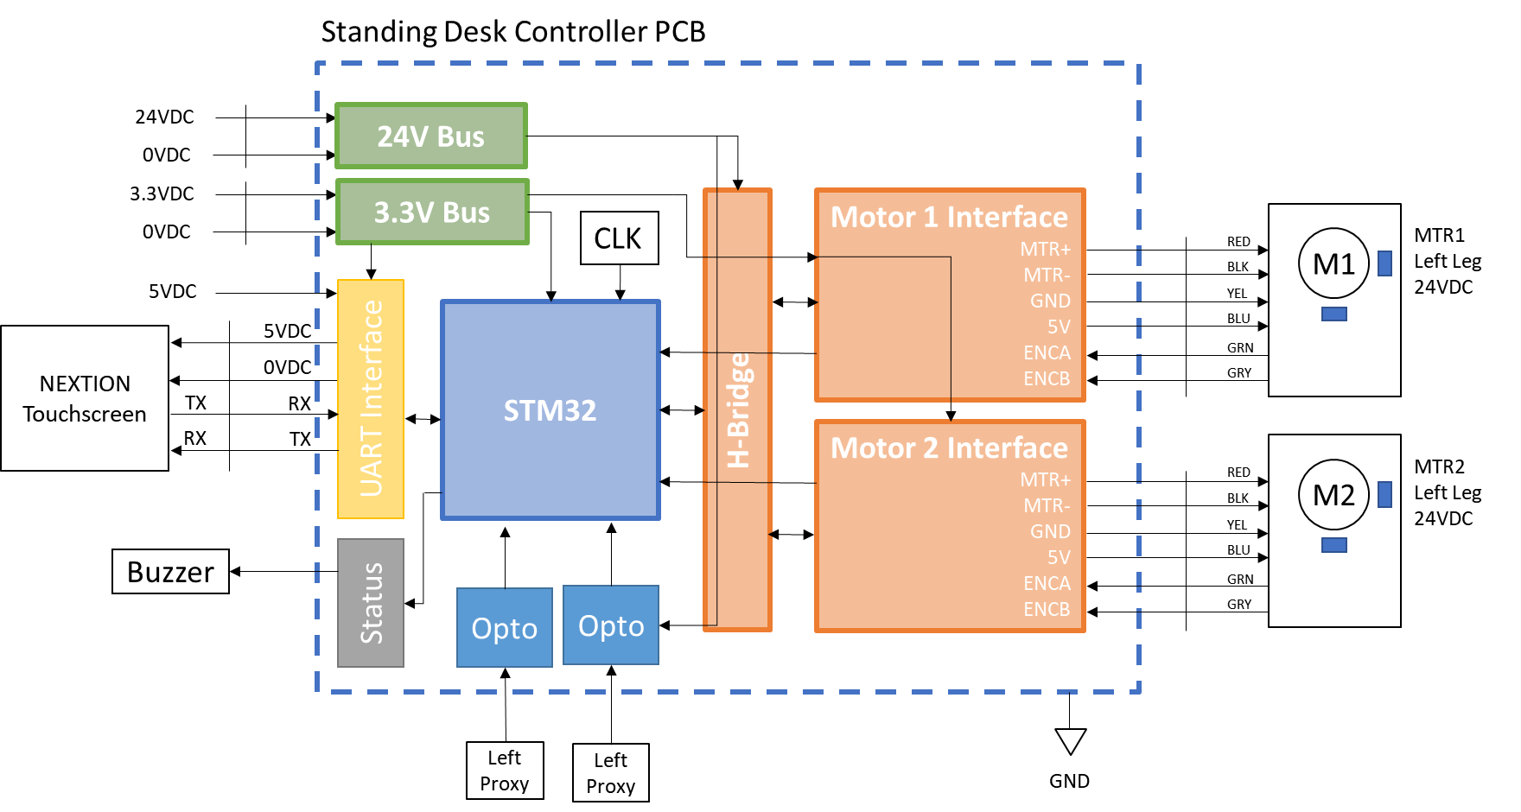
Notes:
Corey
Here is a block-level representation of our design. We have an STM32 microcontroller that handles all of the logic. On the left, we have our touchscreen that communicates with the microcontroller over UART. At the bottom, we have two proximity sensors with octo-couplers that serve as limit switches. When a leg of the desk reaches a low point, an interrupt is raised. On the right, we have our motor interface, where each motor is driven by a PWM signal, and each motor has an encoder to help us keep track of its position. Our design separates the power supplies- we have a 24 volt power supply for the motors and 5 and 3.3 volts for the other components.

Slide 9
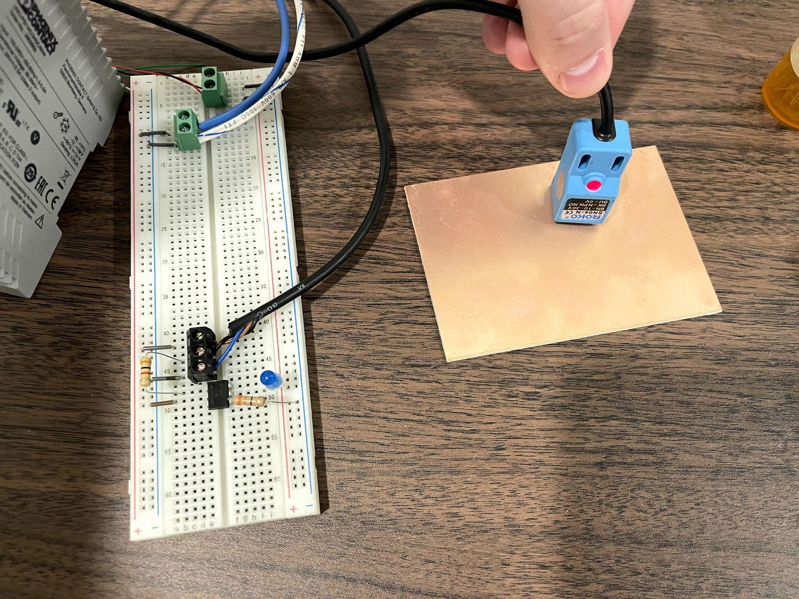
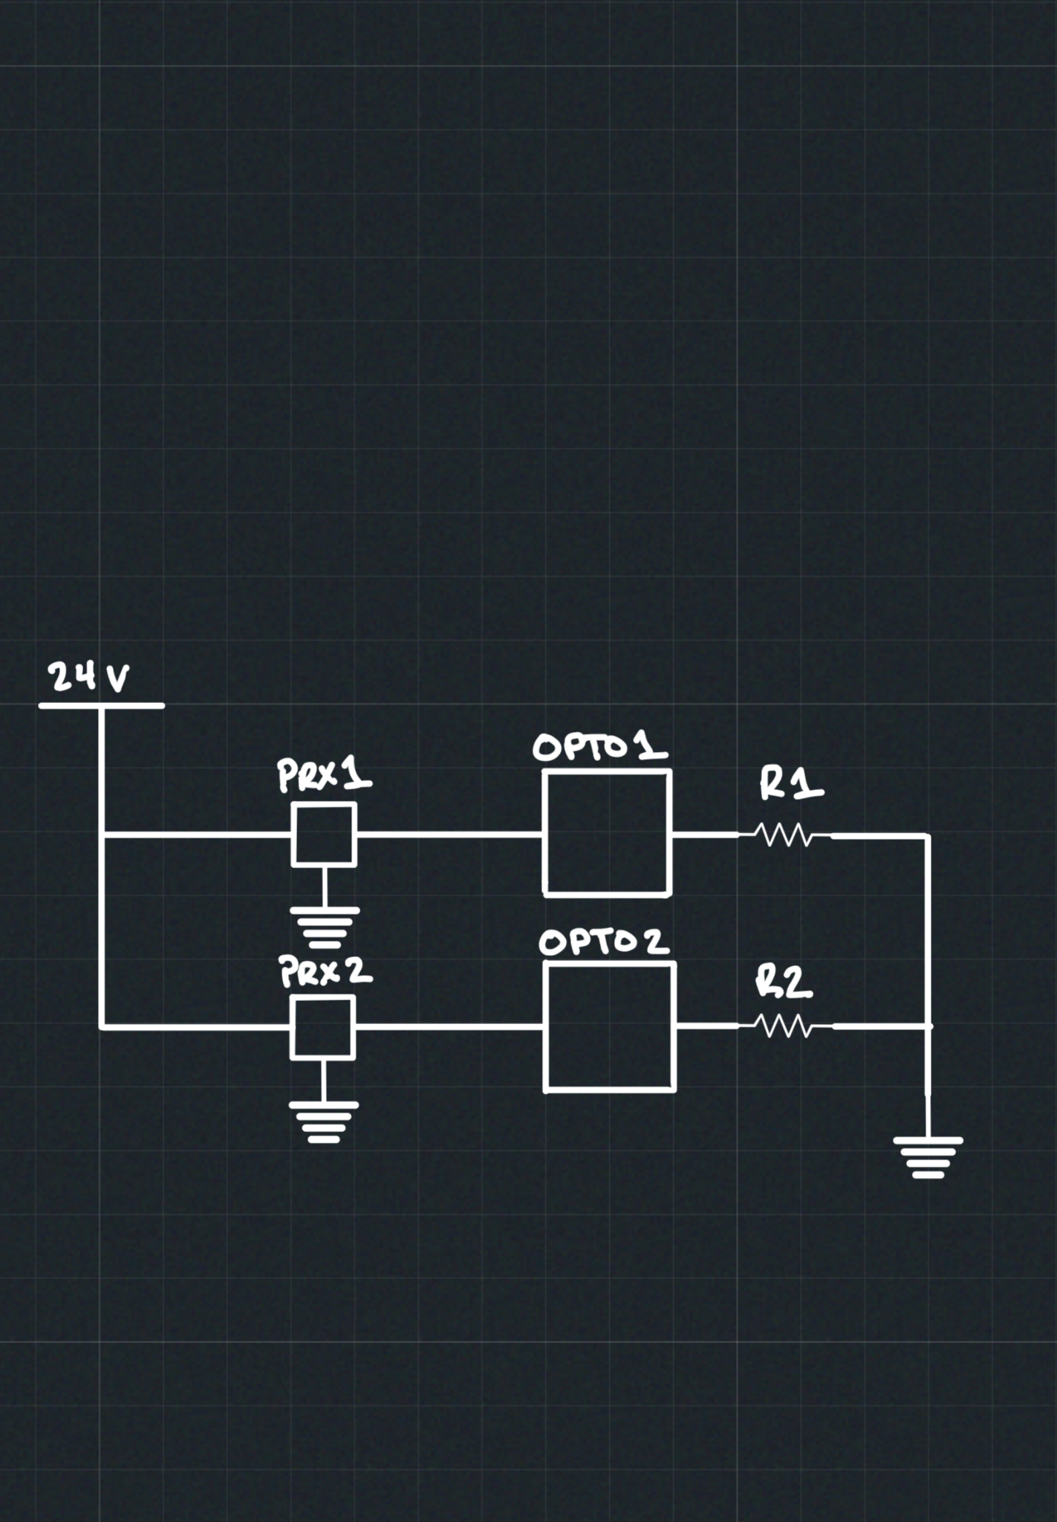
Limit Sensor Design
NPN Inductive Proximity Sensors N.O.
Designed as Normally Closed for Safety
Notes:
Jason

Slide 10
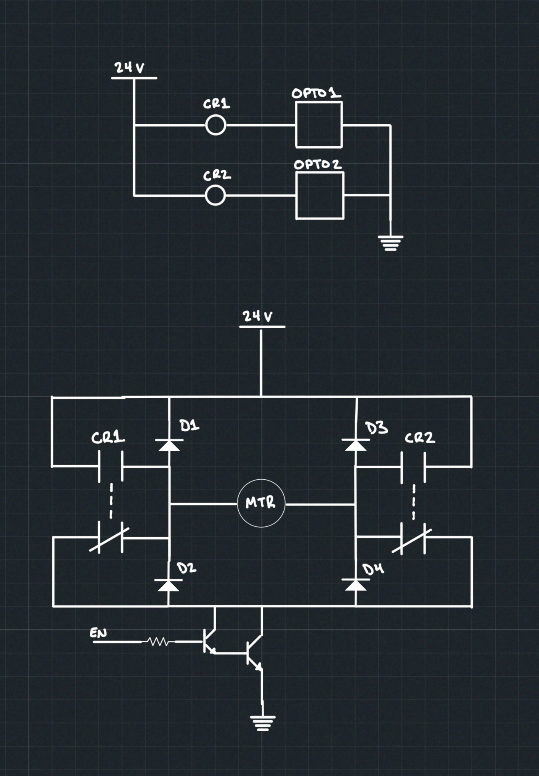
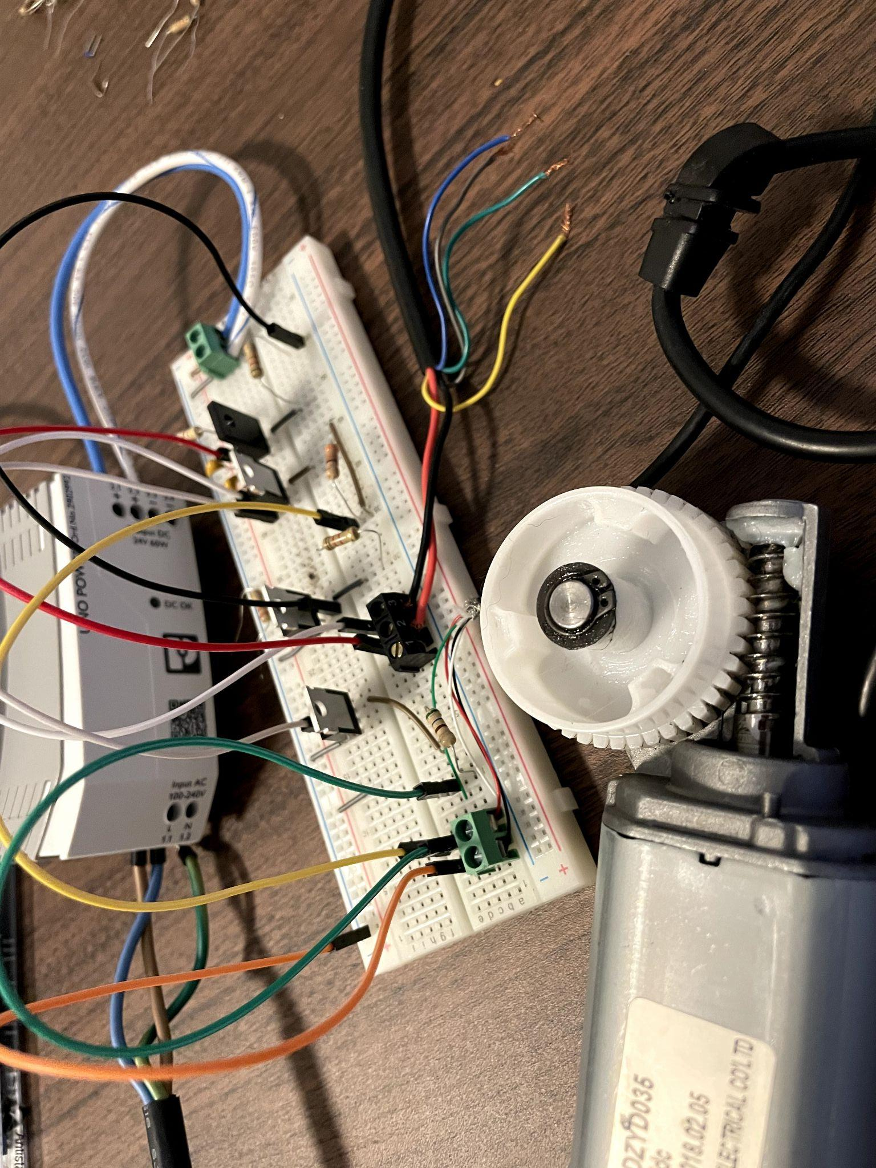
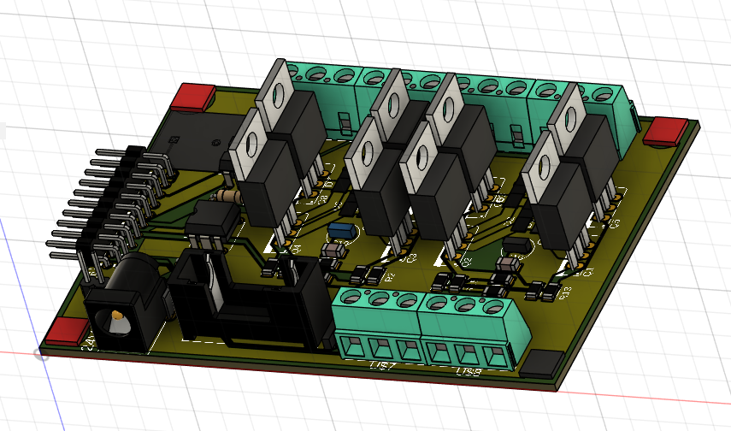
H-Bridge Design
Several testing iterations:
L298N (4A Max, backordered)
Transistor Bridge (min 8 XSTRs per H-Bridge, heat)
Relays + Enable Transistor
Notes:
Jason

Slide 11
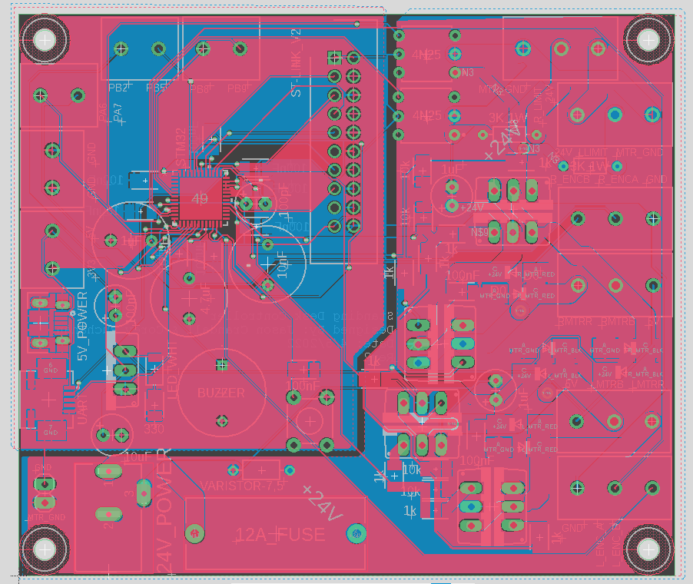
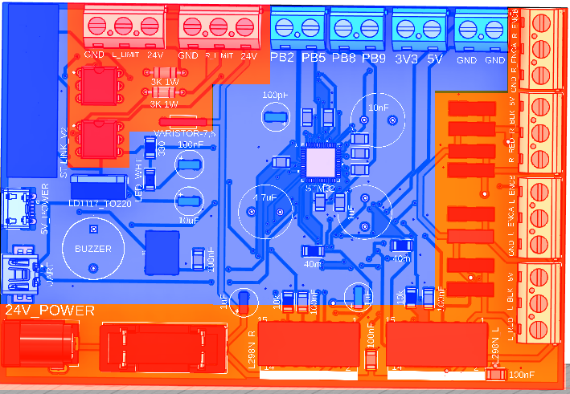
PCB Design
Final Design
Embedded MCU
24V Motor H-Bridges
Major concern of 5-10A traces and Voltage Segregation
First Major Iteration
Notes:
Corey -
We decided to design our own PCB complete with a microcontroller for this project as it would require many hardware components for the motor control and the limit switches anyway. STM32 chips are in short supply, but we found one with bluetooth capability and the peripherals we needed. We figured we could add bluetooth communication as a stretch goal and interface the controller with a phone app. Our design went through several iterations. We first had planned to use L298 H-Bridges to power our motors, but decided to go with a transistor design instead. The current requirement of the motors exceeded the limits of the H-Bridges and we had become aware that they are easy to fry. Also, our first iteration did a poor job of separating the 3.3 and 5 volt components from the 24 volt components. We fixed this in our final design. Though we ordered the PCB from Oshpark soon enough to get it on time to assemble the components and test our design, a FedEx driver lost our package and reported it as delivered. We just received it this week, far too late to assemble and test. Fortunately, we had a backup design and were able to use a protoboard to implement the hardware and interface it with the STM32 Discovery boards we already have.

Slide 12
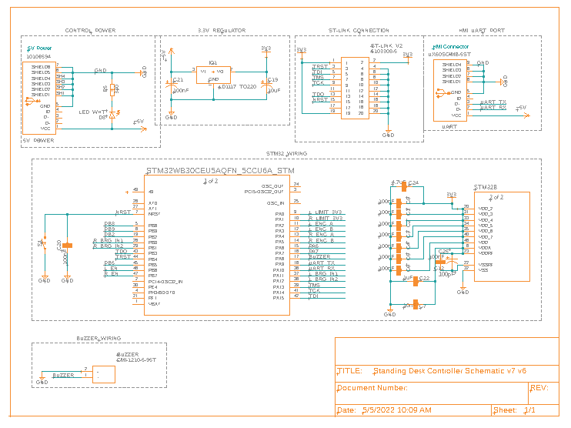
A Closer Look
Notes:
Corey - Here we take a closer look at the PCB schematic. This portion of the schematic mostly deals with the implementation of the STM32 chip on our board. At this stage of the design, it was critical to choose all of the GPIO pins that we would use and select the interrupts to make sure that there were no conflicts. The easiest way to program an STM32 is to connect an ST-Link with the JTAG pins. I was unsure if the JTAG pins could be reused for other components when the board wasn’t being programmed, so I kept them dedicated to the ST-Link. After adding the GPIO connections for the motor control, encoding, limit switches, HMI touchscreen, and buzzer, there were a few extra pins, so we made them available on the board with header pins. One other interesting aspect of implementing a microcontroller on a board is the decoupling capacitance required. Each ground pin requires some decoupling capacitance and the datasheet said to place them as close as possible to the chip connections on the opposite side of the board.

Slide 13
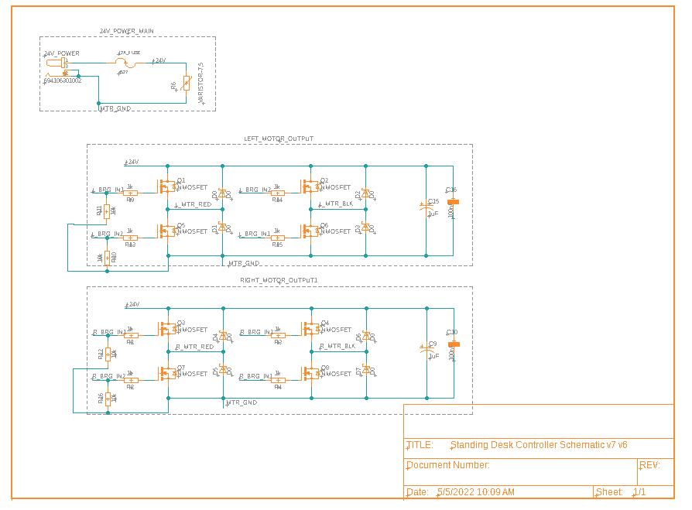
A Closer Look (continued)
Notes:
Jason -

Slide 14
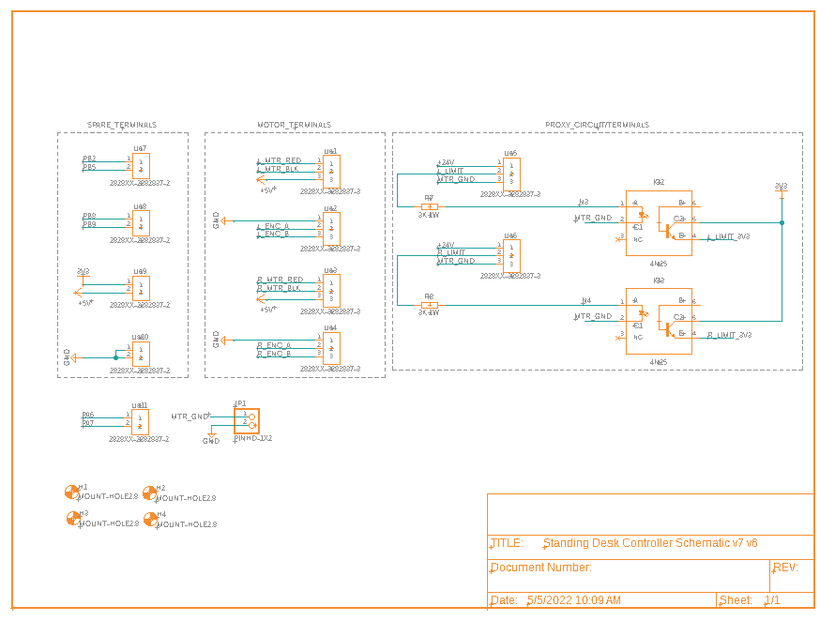
A Closer Look (continued)
Notes:
Jason -

Slide 15
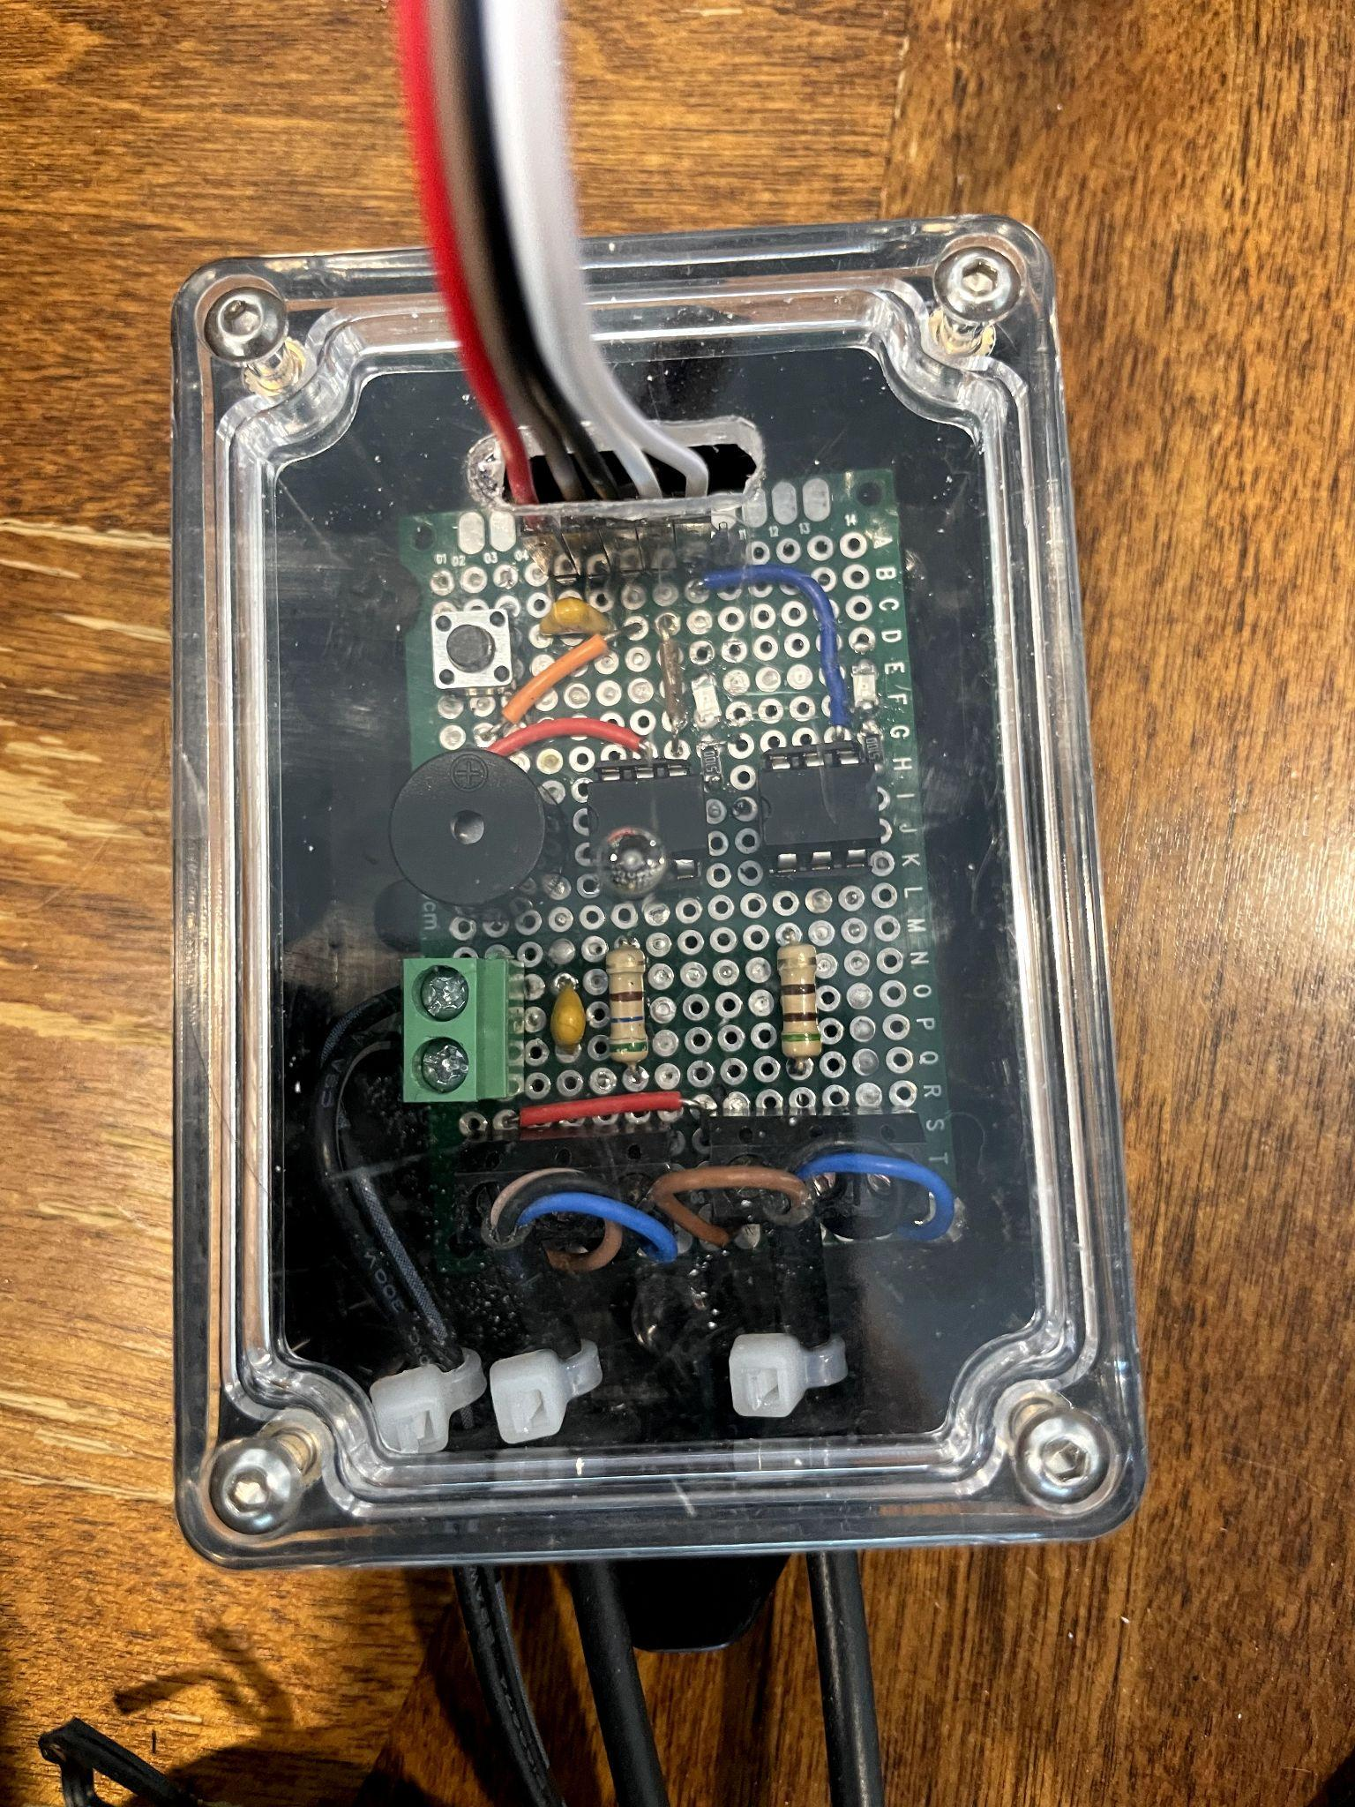
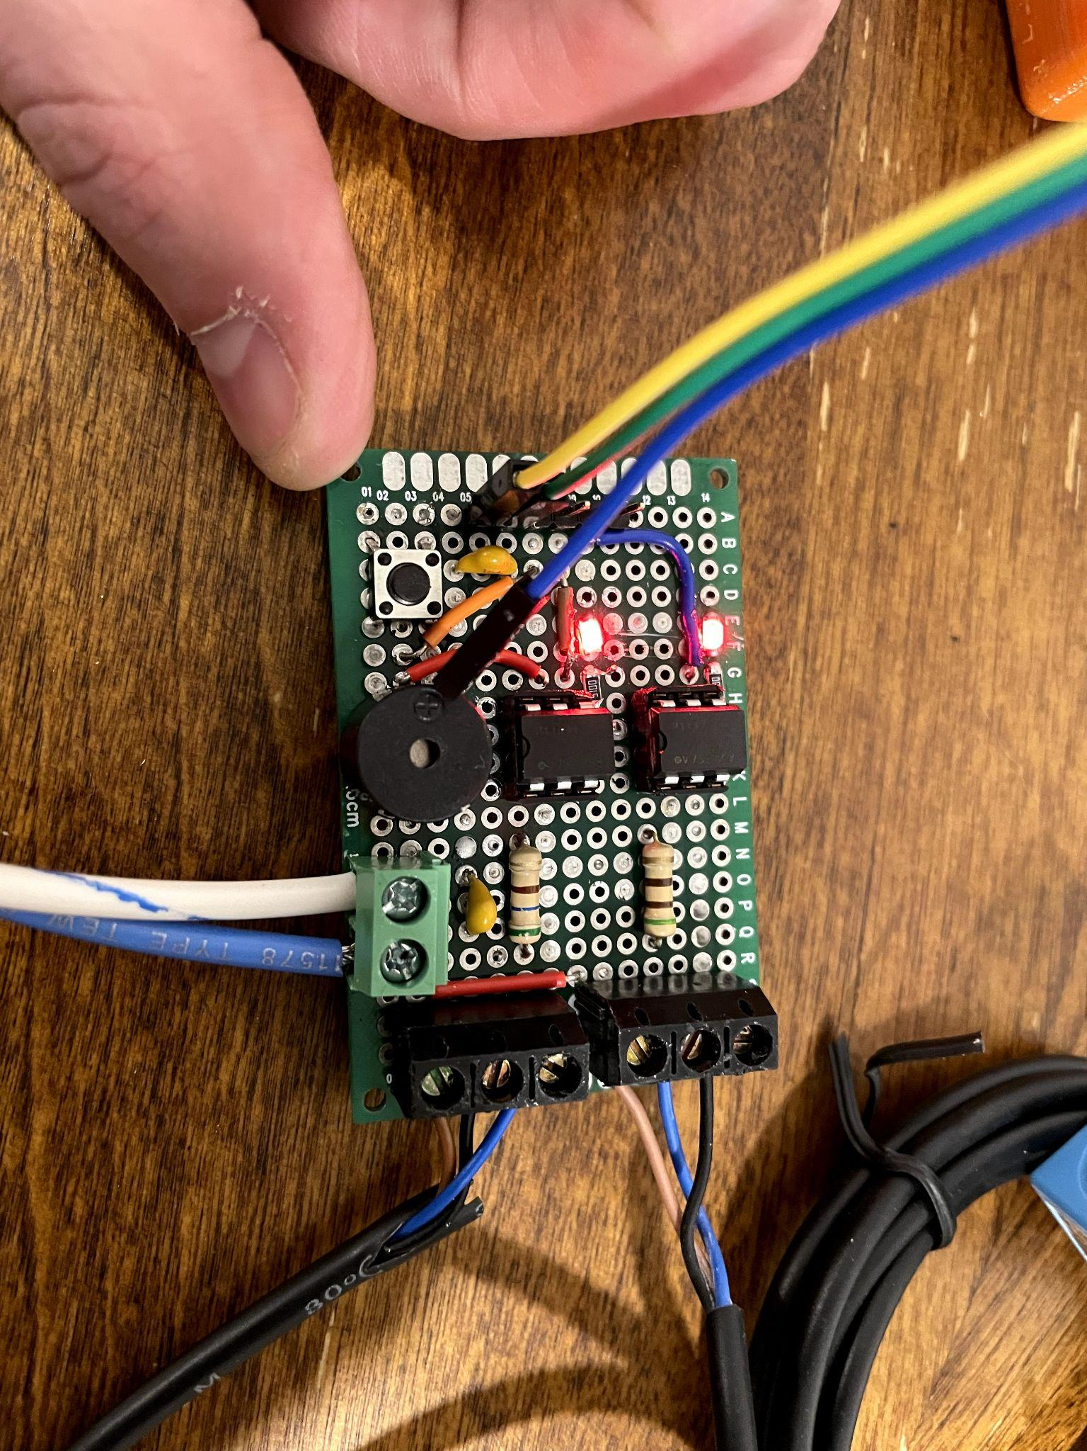
Plan B - Limit Sensor Board
Opto-
couplers
MCU Connections
Proxy 2
Proxy 1
Buzzer w/ Test Button
24V
Notes:
Jason -

Slide 16
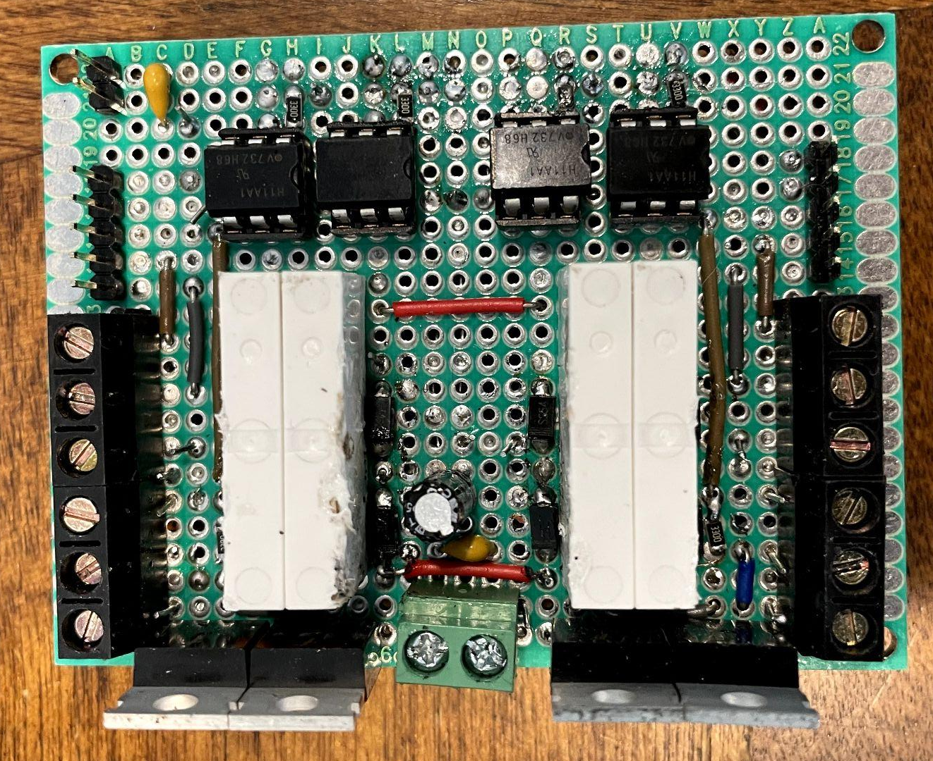
Plan B - H-Bridge Board
Optocouplers
5V
MCU
Connections
Relays
Motor Connections
Enable
XSTRs
24V
Notes:
Jason -

Slide 17
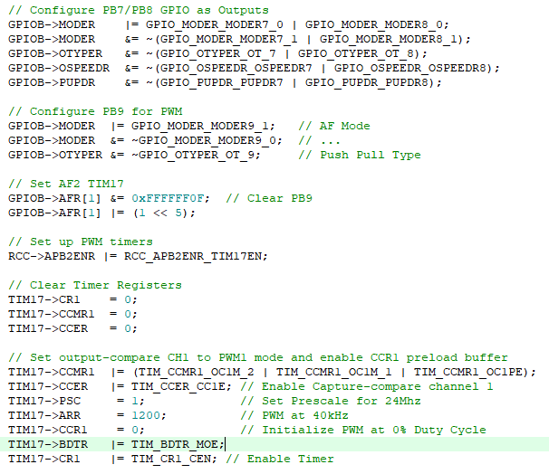
PWM For Motor Control
Enable Transistor Switching Frequency = 2MHz
PWM Frequency = 40 kHz
Notes:
Jason -

Slide 18
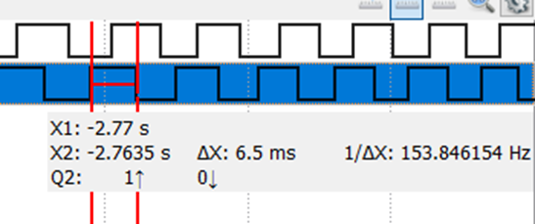
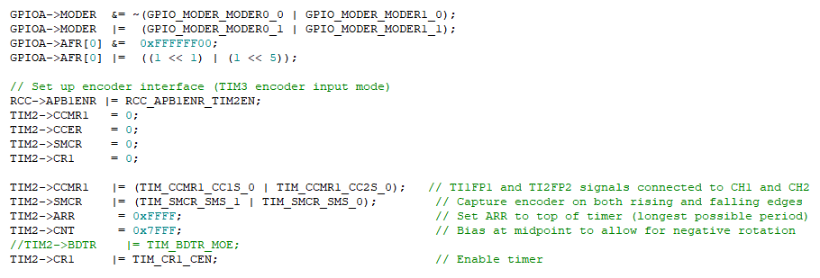
Quadrature Control
Too slow for speed PID controller.
Notes:
Jason -

Slide 19
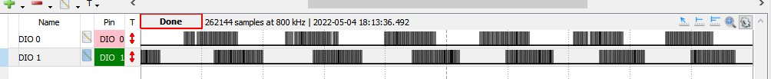
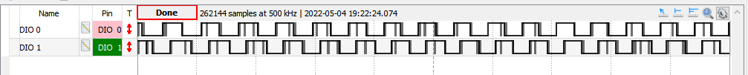
Encoder Behavior Deteriorated
Preliminary Testing
Board Integration
Isolated Testing
Resulted in migrating position counter (sometimes in no-motion state)
Notes:
Jason

Slide 20
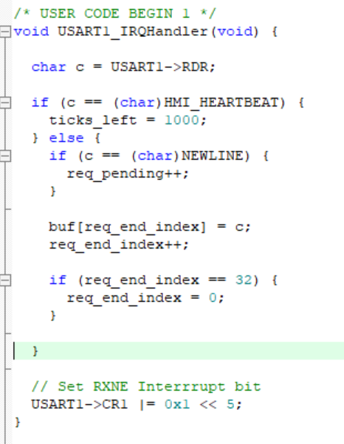
Non-Blocking UART for HMI Commands
115200 Baud Rate
Ring Buffer
Notes:
Corey -
The HMI communicates with the controller over UART, but we didn’t want to block operation of our finite state machine while waiting for user input, so we implemented it to be non-blocking. To do this, we simply enable the interrupt handler in the EXTI and the USART. Since commands can be more than one character, we don’t handle them in the interrupt handler, but rather store them in the ring buffer for the main loop to read when a full command is complete. Commands are terminated by a newline character. You’ll also notice a heartbeat command from the HMI, signifying that it is still operating. The ticks_left variable gets decremented in the systick handler. If ticks_left reaches zero, that means the HMI hasn’t communicated for a full second. The motors are then shut off for safety. The heartbeat character only resets the ticks_left variable, it never enters the buffer.

Slide 21
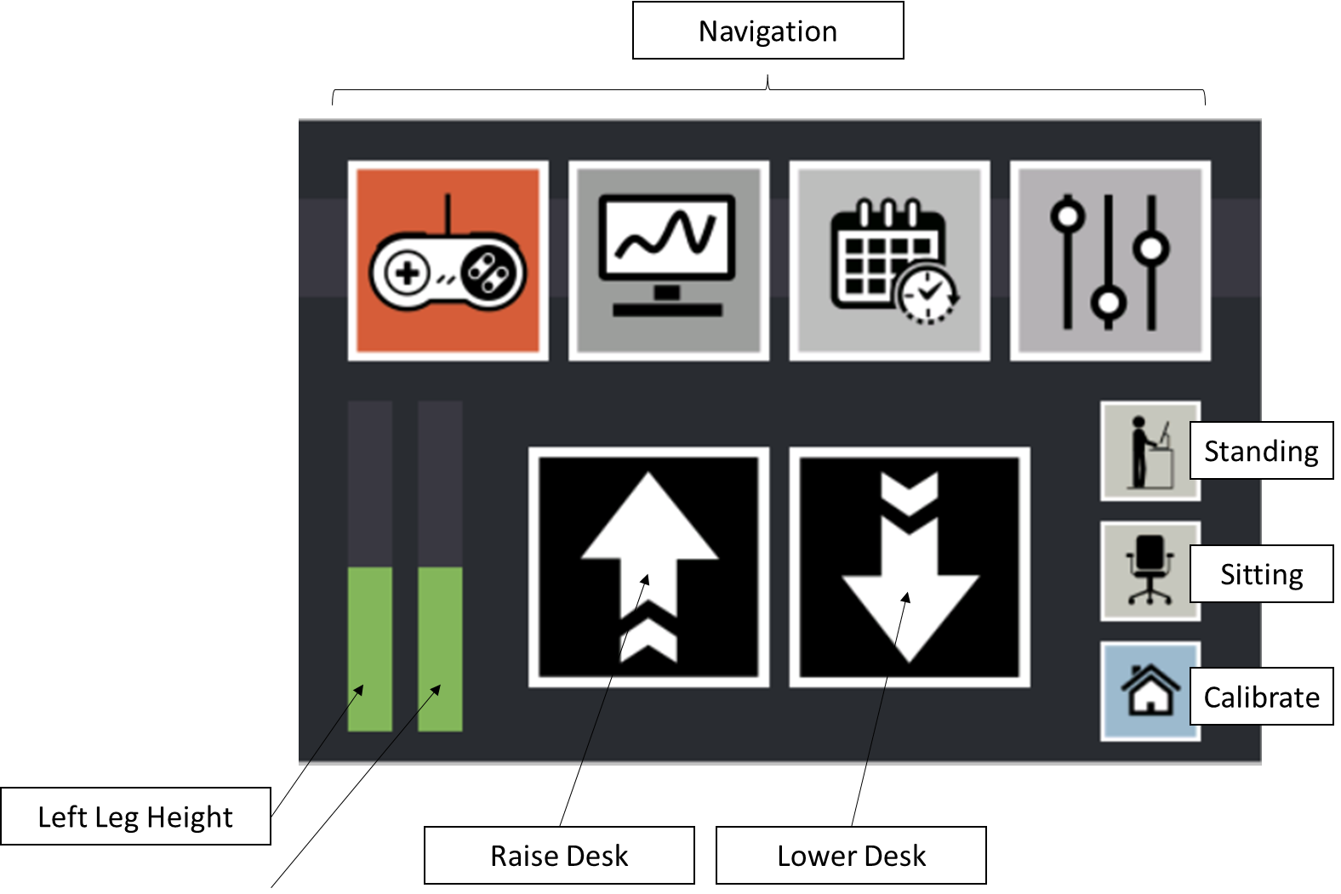
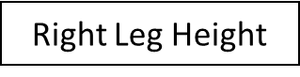
HMI Control Screen
Manual Controls
Raise Desk
Lower Desk
Home
Targeting Controls
Go to Stand Position
Got to Sit Position
Notes:
Corey
Here’s a look at our HMI interface. The user sends commands that directly affect the state of the controller and motors. This design has position indicators on the left, manual controls on the middle, and buttons for raising or lowering the desk to targeted positions on the right. Unfortunately, the height indicators and targeted positions do not function because of the issue with our encoders.

Slide 22
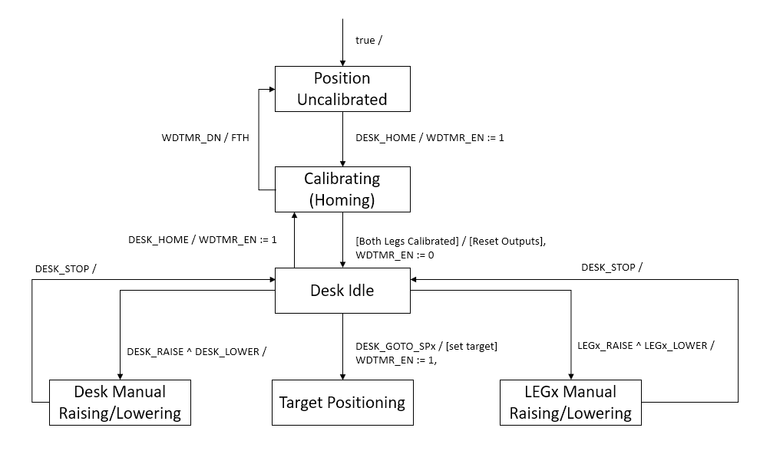
FSM
Notes:
Corey -
Here is an overview of the FSM that we implemented. When the controller is powered on, the desk is an uncalibrated state. The user presses the homing button, which lowers the desk until the left and right limit switches are triggered. The desk is now in an idle state where the user may press down a button on the HMI to raise or lower one or both of the legs of the desk. The motors are powered and the desk moves until the user releases the button and a stop command is sent. We weren’t able to implement the target positioning state as the encoder hardware was damaged.

Slide 23
Milestones Delivered
Milestone 1
GPIO and interrupt list created
PCB Designed and Ordered
Touch screen tested to work properly
Milestone 2
GPIO configured
Interrupts handled
PCB got lost, so we had to make solder necessary components onto a protoboard last minute.
Milestone 3
Touchscreen interface completed
Had to make some modifications due to damaged encoders
No targeting modes or set desk positions
Complete manual user control
Homing
Notes:
Jason -

Slide 24

Notes:
Jason

Slide 25
Conclusion
Successfully implemented a viable controller with main features
Improvised for PCB which will be addressed in the future
Encoders need to be replaced or new circuitry implemented
Target positioning in future scope
Notes:
Corey
In conclusion, we were able to implement useful standing desk controller. The user can use the touchscreen to move the desk up and down, and we have lower limit switches that prevent the motors from damaging the desk. We had to improvise for the PCB not showing up on time, but that can be assembled in the future. We weren’t able to fully implement targeted positioning, but that was due our encoders being damaged. That can be remedied in the future with new hardware.

